Slide 1
An Usability Design Approach of Tailored Visualizations for Mobile Applications
Diploma Thesis book
from Romana Jakob, BSc

Slide 2
Circle Accent Timeline
Date
Find topic
Write proposal
1st December 2017
Literature research
Date
Event title
Event title
Date
Event title
Date
Event title
Present Proposal

Slide 3
Write first

Slide 4
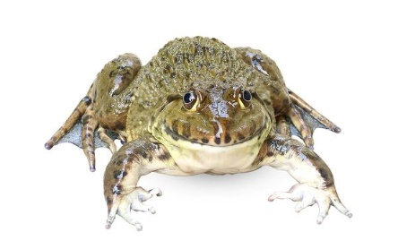
Monday, 12/04/17
Clean Repository
Today I‘m postprocessing the master thesis proposal presentation of friday
Gerhard Nachricht
Pohl Nachricht
Clean Repository

Slide 5
Monday, 12/04/17
Clean Repository
What is going on with my work? I‘m having a terrible time clearing out my schedule. I‘m doing favors for all my friends, and if I don‘t stop giving myself these excuses for not working, I‘m never going to finish my thesis! How can I make sure that I write before I talk on the phone, before I meet Harry for tea, before I comb the dog?
Gerhard Nachricht
Pohl Nachricht
Clean Repository

